Slide 1
Computer Operating System Experiment

Slide 2

Information
Instructor
  Tianhai Zhao (赵天海)
Contact info
  zhaoth@nwpu.edu.cn
Office
  301,Yongzi building, YouYi campus
Online discussion group
  Use your student ID and name
Computer Operating System Experiment

Slide 3
Main Topic
Linux Basic, Shell
Unix Processes
Interprocess communication
POSIX Pthreads
Synchronization
Dining philosophers
Memory allocation
File system interface
…

Slide 4
Linux Basics, C programming and Tools
Lab 1

Slide 5
Roadmap
What is Unix?
What is Linux?
Which Linux Distribution is better?
Commands
Q&A
References

Slide 6
What is Unix?
A multi-task and multi-user Operating System
Developed in 1969 at AT&T’s Bell Labs by
  Ken Thompson (Unix)
  Dennis Ritchie (C)
  Douglas Mcllroy (Pipes - Do one thing, do it well)
Some other variants: System V, Solaris, SCO Unix, SunOS, 4.4BSD, FreeBSD, NetBSD, OpenBSD, BSDI

Slide 7

What is Linux?
A clone of Unix
Developed in 1991 by Linus Torvalds, a Finnish graduate student
Inspired by and replacement of Minix
Linus' Minix became Linux
Consist of
  Linux Kernel
  GNU (GNU is Not Unix) Software
  Software Package management
  Others
http://www.linuxdevices.com/files/misc/ibm-watchpad.jpg

Slide 8

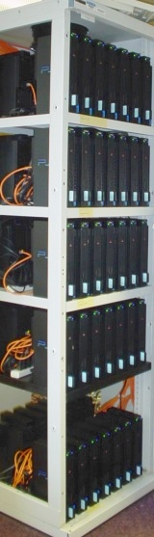
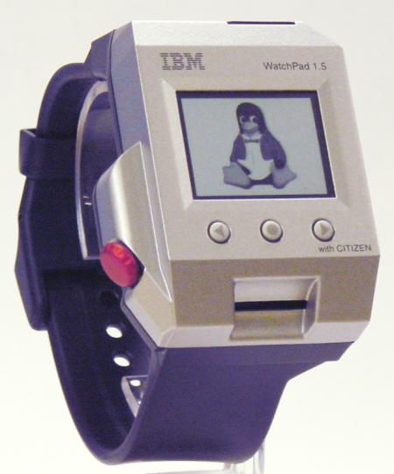
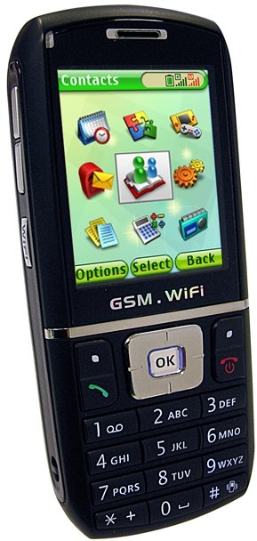
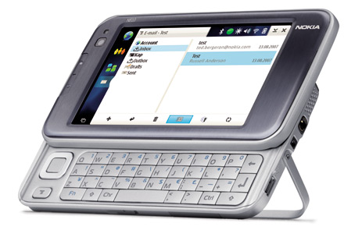
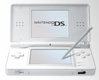


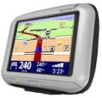
What is Linux?
Originally developed for 32-bit x86-based PC
Ported to other architectures, eg.
  Alpha, VAX, PowerPC, IBM S/390, MIPS, IA-64
  PS2, TiVo, cellphones, watches, Nokia N810, NDS, routers, NAS, GPS, …
* See references at the end
for the corresponding websites.

Slide 9
Which Linux Distribution is better?
> 300 Linux Distributions
  Redhat
    RHEL (commercially support)
    Fedora (free)
  CentOS (free RHEL)
  SuSe ( based in German)
  Gentoo (Source code based)
  Debian (one of the few called GNU/Linux)
  Ubuntu (based in South Africa)
  Knoppix (first LiveCD distro.)
  …

Slide 10
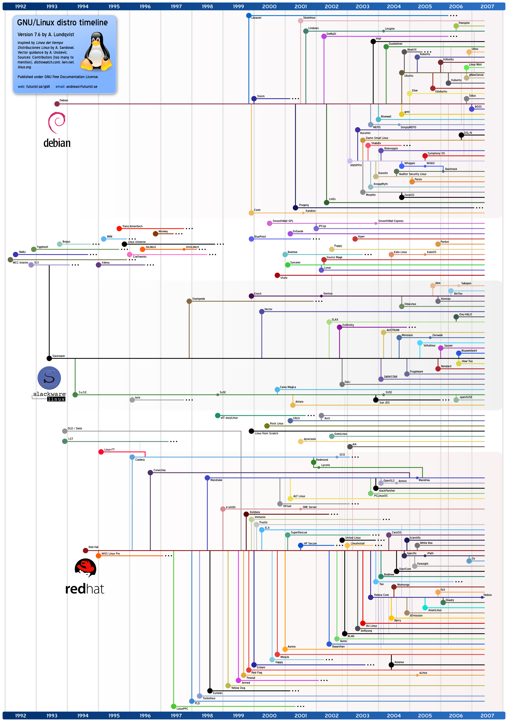
Which Linux Distribution is better?
Ubuntu
Debian
Knoppix
Slackware
Gentoo
CentOS
Redhat
Source:
http://futurist.se/gldt/
http://www.cs.ucr.edu/~weesan/cs183/

Slide 11


Which Linux Distribution is better?
Ask yourself these questions
  Is it going to be around in 5 yrs?
  Is it giong to stay on top of the latest security patches?
  Is it going to release updated software promptly?
  If I have problems, will the vendor talk to me?
Personally, I use Ubuntu or Centos

Slide 12
Operating System Case Study: Linux
Applications: Compilers, word processors, X-based GUI
AUI
LINUX Shell: Bourne Again (bash), TC, Z, etc.
Language libraries
API
System call interface
Memory management
File management
Process Management
Kernel
Device Drives
BIOS
Computer Hardware

Slide 13
Linux File System Structure
According to the File System Standard (FSSTND) proposed in 1994, every LINUX system should contain a set of standard files and directories
root /
directories
bin
lib
lost+found
mnt
opt
root
sbin
var
boot
dev
etc
proc
home
tmp
usr
file
…
dlun
guest
bin
lib
local
fd
hd
hd
group
passwd
Notes:
Root Directory ( / )
Top of the file system. Similar to \ in DOS
/bin
Contain the binary (executable code) of most essential Linux commands, e.g. bash, cat, cp, ln, ls, etc.
/boot
Contain all the files needed to boot the Linux system, including the binary of the Linux kernel. E.g., on Red Hat Linux 6.1, the kernel is in /boot/vmlinux-2.2.5-15 file
/dev
Contain the special files for devices, e.g. fd0, hd0, etc
/etc
Contain host-specific files and directories, e.g. information about system configuration
/etc/passwd
This file contains login information of users in the system
For every user, one line of record is stored in the following format:
/home
Contain the home directories of every user in the system, e.g. dlun, guest, etc
/lib
Store all essential libraries for different language compilers
/lost+found
Contain all the files on the system not connected to any directory.
System administrator should determine the fate of the files in this directory
/mnt
Use by system administrator to mount file systems temporarily by using the mount command
Before using any devices, they have to be mounted to the system for registration
For example, after mounting a CD-ROM, the file system in it will be mapped to /mnt/cdrom directory
User can then read and write files in the CD-ROM by accessing this directory
Similar to mapping a drive letter to a CD-ROM in Windows
Different from the special file in /dev. Special file is only a place where data of the CD-ROM is transferred or stored. No file system concept
/opt
Use to install add-on software packages, e.g. star office, etc.
/proc
Contain process and system information
/root
Home directory of the user root, usually the administrator
/sbin
The directories /sbin, /usr/sbin, and /usr/local/sbin contain system administration tools, utilities and general root only commands, such as halt, reboot and shutdown
/tmp
Contain temporary files. Usually files in this directory will be deleted from time to time to avoid the system fills with temp files
/usr
One of the largest sections of the Linux file system
Contain read-only data that are shared between various users, e.g. the manual pages needed for the command man. Stored in /usr/man direcrtory
/var
Contain data that keeps on changing as the system is running. E.g. /var/spool/mail directory keeps the mail of user

Slide 14
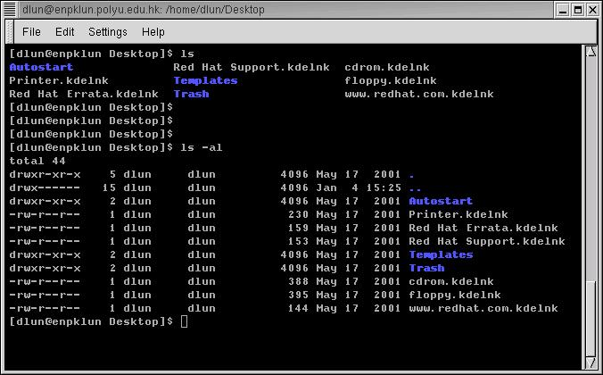
Linux text-based interface
command to show the content of current directory
The prompt $ shows that bash shell is using
command to show the content of current directory with option -al

Slide 15
Linux Shell
whoami
ls
pwd
Shell interprets the command and request service from kernel
Similar to DOS but DOS has only one set of interface while Linux can select different shell
  Bourne Again shell (Bash), TC shell (Tcsh), Z shell (Zsh)
Bash, Tcsh, Zsh
Kernel
Different shell has similar but different functionality
Bash is the default for Linux
Graphical user interface of Linux is in fact an application program work on the shell

Slide 16
Basic Commands
ls
  $ ls -l
  $ ls -a
  $ ls -la
  $ ls -l --sort=time
  $ ls -l --sort=size -r
cd
  $ cd /usr/bin
pwd
  $ pwd
~
  $ cd ~
~user
  $ cd ~weesan
What will “cd ~/weesan” do?
which
  $ which ls
whereis
  $ whereis ls
locate
  $ locate stdio.h
  $ locate iostream
rpm
  $ rpm -q bash
  $ rpm -qa
  $ rpm -qa | sort | less
find
  $ find / | grep stdio.h
  $ find /usr/include | grep stdio.h
Notes:
Frequently used commands available in most shells:
ls : to show (list) the names of the file in the current directory
cd : change directory,
e.g. cd / change to the root directory
cd .. change to the parent of that directory
cp : copy one file to another
e.g. cp abc.txt xyz.txt copy abc.txt to xyz.txt
rm : remove a file
man : ask for the manual (or help) of a command
e.g. man cd ask for the manual of the command cd
pwd : show the name of the present working directory
cat : to show the content of a text file
e.g. cat abc.txt show the content of abc.txt
whoami : to show the username of the current user

Slide 17
Basic Commands (cont)
echo
  $ echo “Hello World”
  $ echo -n “Hello World”
cat
  $ cat /etc/motd
  $ cat /proc/cpuinfo
cp
  $ cp foo bar
  $ cp -a foo bar
mv
  $ mv foo bar
mkdir
  $ mkdir foo
rm
  $ rm foo
  $ rm -rf foo
  $ rm -i foo
  $ rm -- -foo
chgrp
  $ chgrp bar /home/foo
chsh
  $ chsh foo
chfn
  $ chfn foo
chown
  $ chown -R foo:bar /home/foo

Slide 18
Basic Commands (cont)
tar
  $ tar cvfp lab1.tar lab1
gzip
  $ gzip -9 lab1.tar
untar & ungzip
  $ gzip -cd lab1.tar.gz | tar xvf –
  $ tar xvfz lab1.tar.gz
touch
  $ touch foo
  $ cat /dev/null > foo
Pipe
  $ cal > foo
  $ cat /dev/zero > foo
  $ cat < /etc/passwd
  $ who | cut -d’ ‘ -f1 | sort | uniq | wc –l
backtick
  $ echo “The date is `date`”
  $ echo `seq 1 10`
Hard, soft (symbolic) link
  ln vmlinuz-2.6.24.4 vmlinuz
  ln -s firefox-2.0.0.3 firefox

Slide 19
Basic Commands (cont)
Disk usage
  $ df -h /
File space usage
  $ du -sxh ~/
Advance stuff ☺
  $ ssh eon who
  $ ssh eon ‘cd .html ; tar cvfp - cs183 | gzip -9c’ | tar xvfpz -
  $ ssh kilo-1 ‘tar cvfp - /extra/weesan’ | tar xvfp - -C /

Slide 20
Vi
2 modes
  Input mode
    ESC to back to cmd mode
  Command mode
    Cursor movement
      h (left), j (down), k (up), l (right)
      ^f (page down)
      ^b (page up)
      ^ (first char.)
      $ (last char.)
      G (bottom page)
      :1 (goto first line)
    Swtch to input mode
      a (append)
      i (insert)
      o (insert line after
      O (insert line before)
    Delete
      dd (delete a line)
      d10d (delete 10 lines)
      d$ (delete till end of line)
      dG (delete till end of file)
      x (current char.)
    Paste
      p (paste after)
      P (paste before)
    Undo
      u
    Search
      /
    Save/Quit
      :w (write)
      :q (quit)
      :wq (write and quit)
      :q! (give up changes)

Slide 21
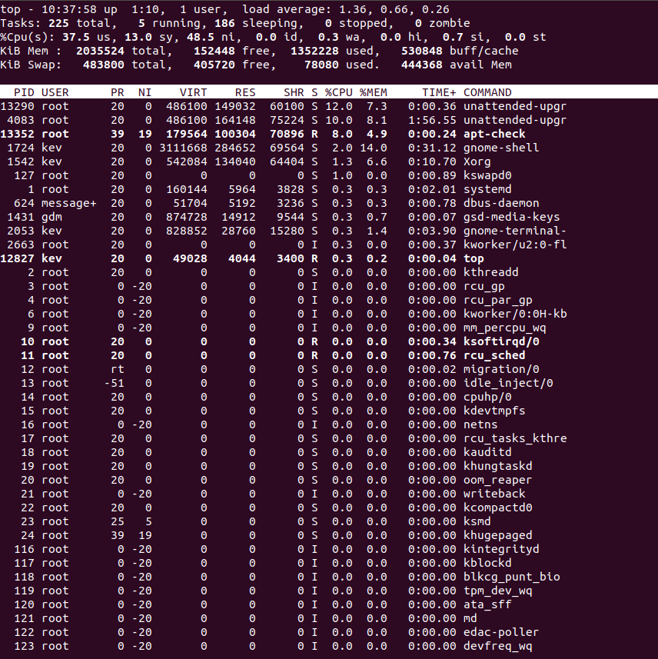
Advanced Commands
top is a text user interface for viewing the most active processes on your system. Press q to quit. Press c to show full commands.

Slide 22
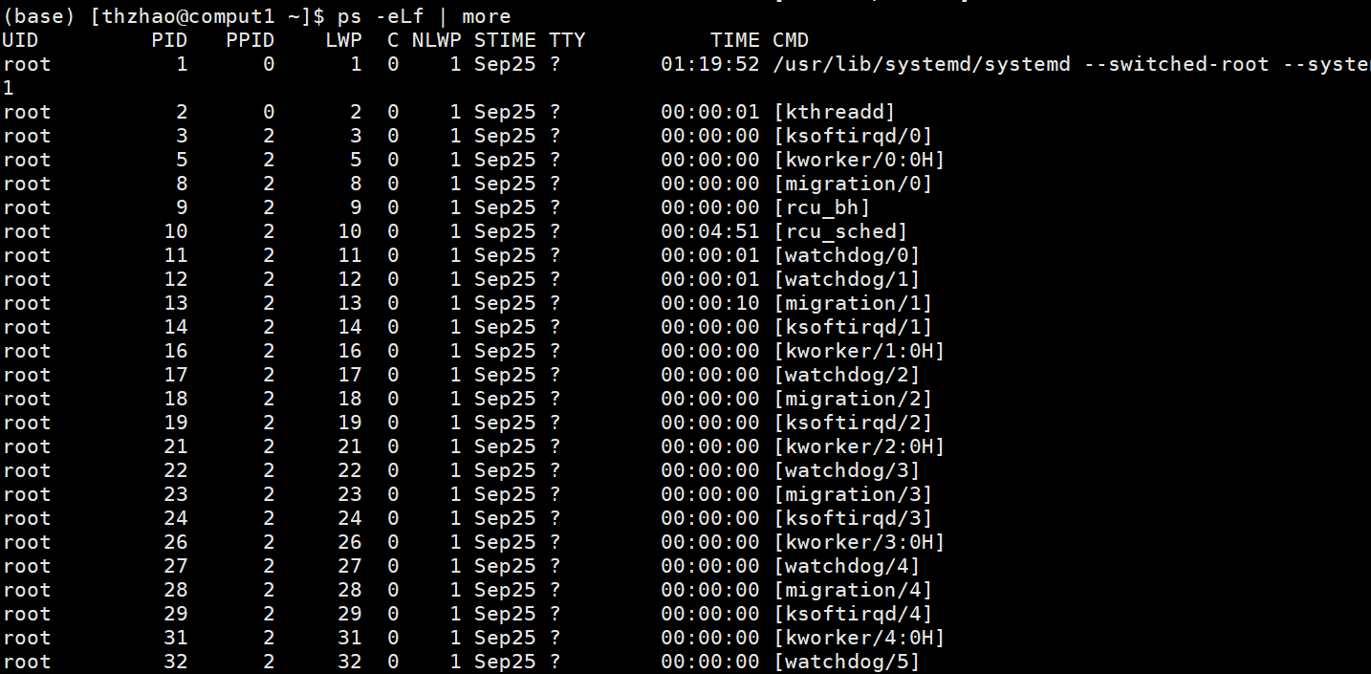
ps
ps prints out a list of running processes.
pidof and pgrep
pidof <process name> gets you the process ID of a single running process.

Slide 23
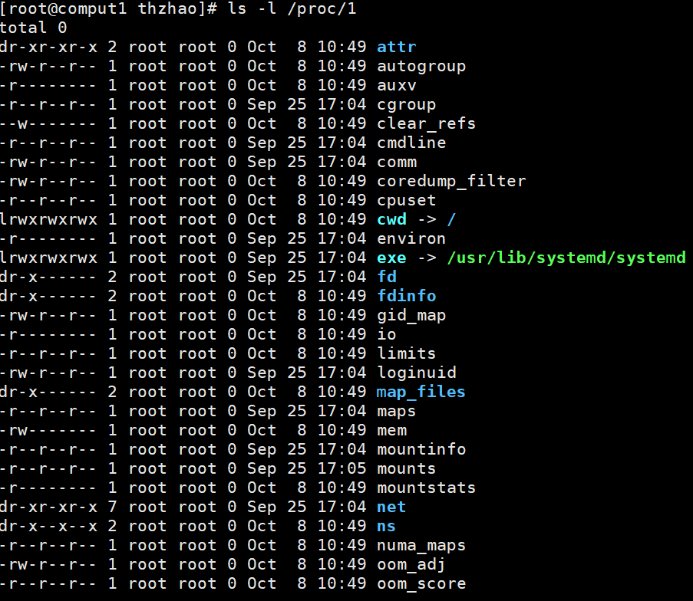
/proc directory
The /proc directory on Linux is a gold mine of information.
cmdline { The command used to start the process
• cwd { The current working directory of the process
• environ { The environment variables of the process
• exe { The program that is running in the process
• fd/ { A list of the file descriptors of the process
• fdinfo/ { More information about the file descriptors
• maps { The memory map of the process
• net { Details about network configuration
• status { Status of the process

Slide 24
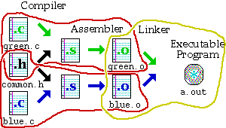
Makefiles
Provide a way for separate compilation.
Describe the dependencies among the project files.
The make utility.
Notes:
Makefiles provide a way for separate compilation. When a file from a project is changed, only the files that depend on the changed file are compiled.

Slide 25
Sample makefile
Makefiles main element is called a rule:
Example:
my_prog : eval.o main.o
g++ -o my_prog eval.o main.o
eval.o : eval.c eval.h
g++ -g -c eval.c
main.o : main.c eval.h
g++ -g -c main.c
_________________________
# -o to specify executable file name
# -c to compile only (no linking)
target : dependencies
TAB commands #shell commands

Slide 26
gdb
GDB is invoked with the shell command gdb.
Once started,it reads commands from the terminal until you tell it to exit with the GDB command quit.
  The most usual way to start GDB is with one argument or two, specifying an executable program as the argument:
  obelix > gdb program
  You can also start with both an executable program and a core file specified:
    obelix > gdb program core
  You can, instead, specify a process ID as a second argument, if you want to debug a running process:
    obelix> gdb program 1234
  would attach GDB to process 1234

Slide 27
Compiling with the –g Option
To use gdb best, compile your program with:
  gcc –g –c my_math.c
  gcc –g –c sample.c
  gcc –o sample my_math.o sample.o
  or:
  gcc –o sample -g my_math.c sample.c
That is, you should make sure that –g option is used to generate the .o files.
  This option tells the compiler to insert more information about data types, etc., so the debugger gets a better understanding of it.

Slide 28
Common Commands for gdb
Here are some of the most frequently needed GDB commands:
  b(reak) [file:]function Set a breakpoint at function (in file).
  r(un) [arglist] Start program (with arglist, if specified).
  bt or where Backtrace: display the program stack; especially
  useful to find where your program crashed or
  dumped core.
  print expr Display the value of an expression.
  c Continue running your program (after stopping, e.g. at a breakpoint).
  n(ext) Execute next program line (after
  stopping); step over any function calls in
  the line.
  s(tep) Execute next program line (after
  stopping); step into any function calls in the line.
  help [name] Show information about GDB command name,
  or general information about using GDB.
  q(uit) Exit from GDB.
  l(ist) print the source code

Slide 29
ssh
Connect to 202.117.249.6
  ssh os_ex@202.117.249.6
  User: os_en
ftp
  ftp 202.117.249.6
  Input username and password
  ftp> quote pasv
  227 Entering Passive Mode (192,168,0,112,164,248).
  ftp> passive
  Passive mode on.
  cd /public/home/os_en/os_ex/Lab_1
  get Lab1.pdf

Slide 30
References
Unix history
  http://en.wikipedia.org/wiki/Unix
  http://upload.wikimedia.org/wikipedia/commons/7/77/Unix_history-simple.svg
Linus Torvalds
  http://en.wikipedia.org/wiki/Linus_Torvalds
Linux Kernel
  http://www.kernel.org/

Slide 31
References
GNU (Gnu’s Not Unix)
  http://www.gnu.org/
Linux Distribution
  http://en.wikipedia.org/wiki/Linux_distribution
  http://en.wikipedia.org/wiki/List_of_Linux_distributions
Weesan CS183
  http://www.cs.ucr.edu/~weesan/cs183/
Berkey CS162
  https://www2.eecs.berkeley.edu/Courses/CS162/

